Slide 1
Computer Networks (CSE 3205)
1 / 35

Slide 2
Book List
1. Computer Networks by Andrew S. Tanenbaum
2. Data Communications and Networking by Behrouz A. Forouzan
3. Cryptography and Network Security by Stallings
2 / 35

Slide 3
What is Computer Network?
A computer network is a group of computer systems and other computing hardware devices that are linked together through communication channels to facilitate communication and resource-sharing among a wide range of users.¹
¹https://www.techopedia.com/definition/25597/computer-network
3 / 35

Slide 4
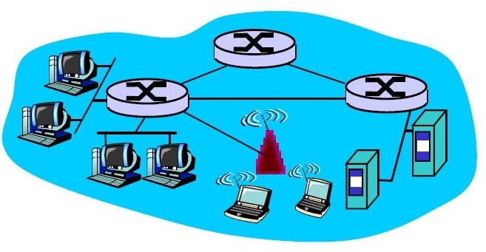
What is Computer Network?
We use Computer network to mean,
A collection of autonomous computers interconnected by a single technology with networking device(s). Two computers are said to be interconnected if they are able to exchange information.
4 / 35

Slide 5
Differences of Computer Network and Distributed System
Computer Network: A collection of autonomous computers interconnected by a single technology with networking device(s).
Distributed System: A collection of autonomous ,independent computers appears to its users as a single coherent system. Usually, it has a single model or paradigm that it presents to the users. Often a layer of software on top of the operating system, called middleware, is responsible for implementing this model.
Example: World Wide Web (WWW)
In a computer network, this coherence, model, and software are absent
.
5 / 35

Slide 6
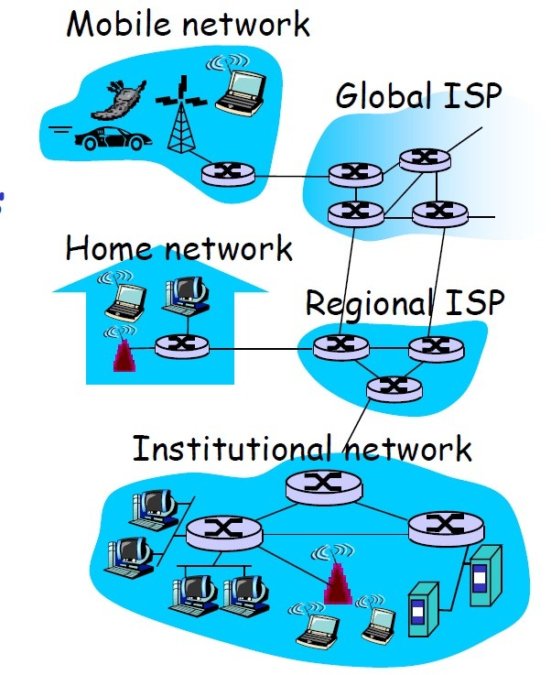
What is Internet?
A network of networks.
6 / 35

Slide 7
1.1 Uses of Computer Network
Business Application: Resource Sharing , VoIP (Voice over IP) IPTV
Home Applications: Peer to Peer Communication
Mobile Users:
Social Issues: Email service, Social networking

Slide 8
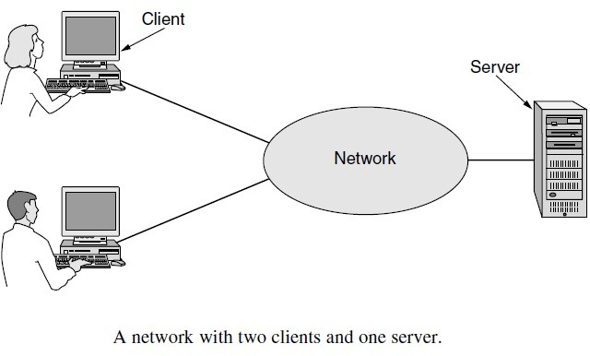
Fundamental of communication

Slide 9
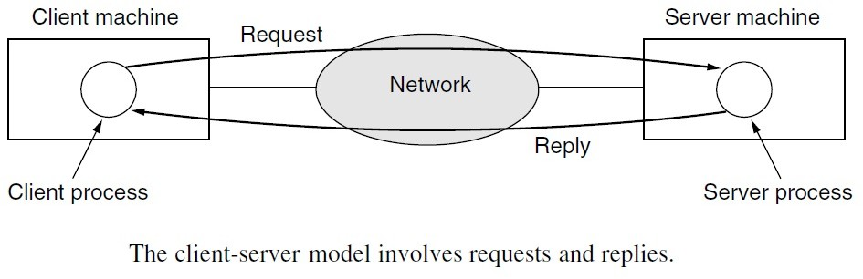
Fundamental of communication

Slide 10
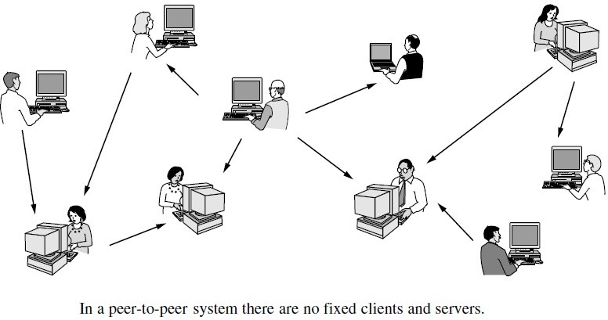
Fundamental of communication

Slide 11
Classification of Network
1.2 NETWORK HARDWARE:
Broadly speaking, there are two types of transmission technology that are in widespread use.
1. broadcast links (Broadcast System) 2. point-to-point links (Unicast System)
25 / 35

Slide 12
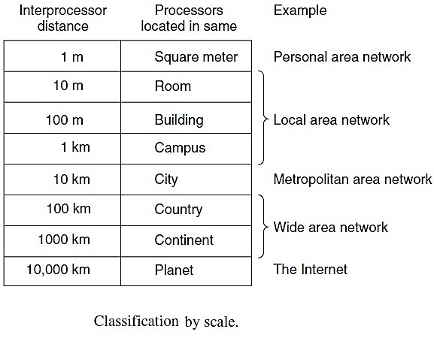
Classification of Network

Slide 13
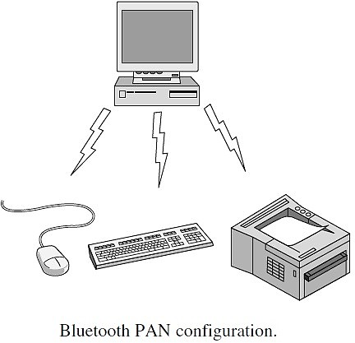
Classification of Network

Slide 14
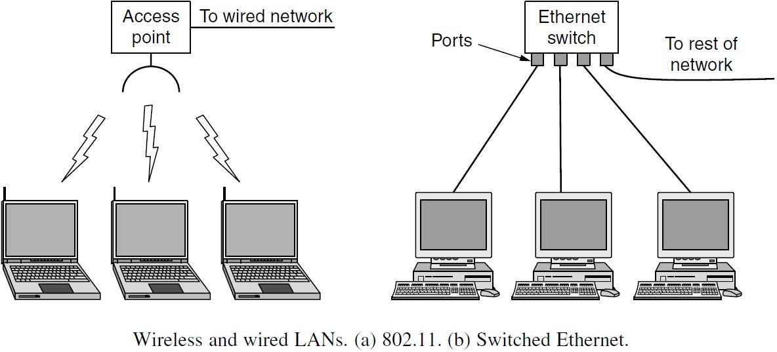
Classification of Network

Slide 15
Classification of Network

Slide 16
Classification of Network

Slide 17
Classification of Network
CAN(Campus Area Network)
A campus network, campus area network, corporate area network or CAN is a computer network made up of an interconnection of local area networks (LANs) within a limited geographical area.²
²https://en.wikipedia.org/wiki/Campus network

Slide 18
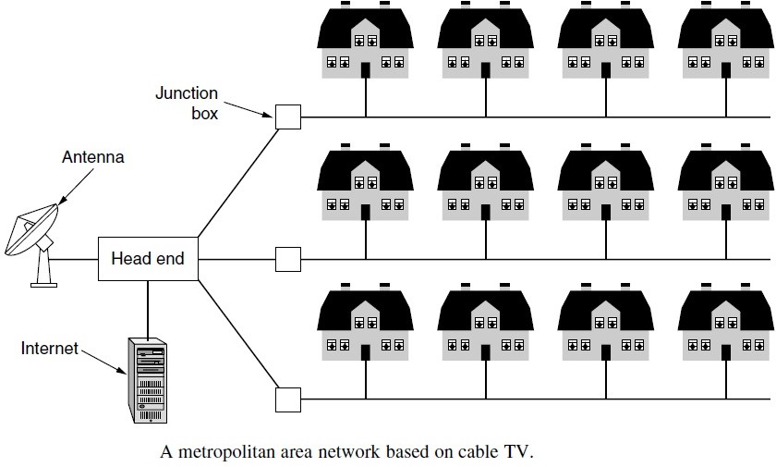
Classification of Network

Slide 19
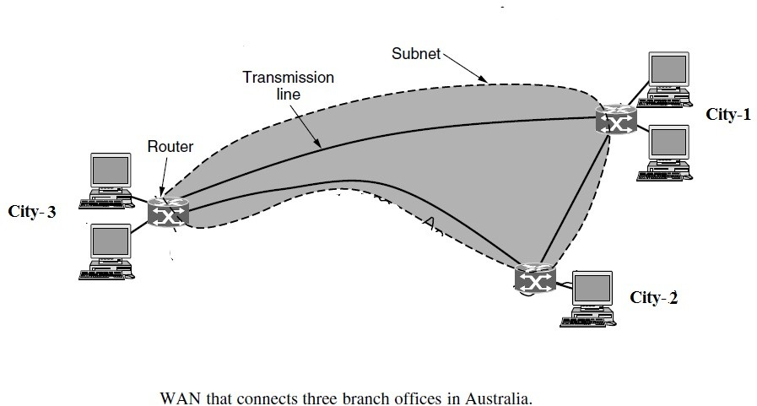
Classification of Network

Slide 20
Internetworking devices
Descending in increasing power and complexity
Hubs
Bridges
Switches
Routers
Gateways

Slide 21
Hub
A hub interconnects two or more workstations into a local area network. A simple interconnecting device that requires no overhead to operate.
When a workstation transmits to a hub, the hub immediately resends the data frame out all connecting links.

Slide 22
Bridges
A bridge can be used to connect two similar LANs, such as two CSMA/CD LANs.
A bridge can also be used to connect two closely similar LANs, such as a CSMA/CD LAN and a token ring LAN.
The bridge examines the destination address in a frame and either forwards this frame onto the next LAN or does not.
The bridge examines the source address in a frame and places this address in a routing table, to be used for future routing decisions.

Slide 23
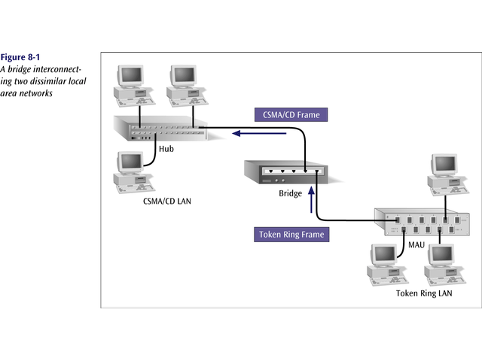
A bridge interconnecting two dissimilar LANs

Slide 24
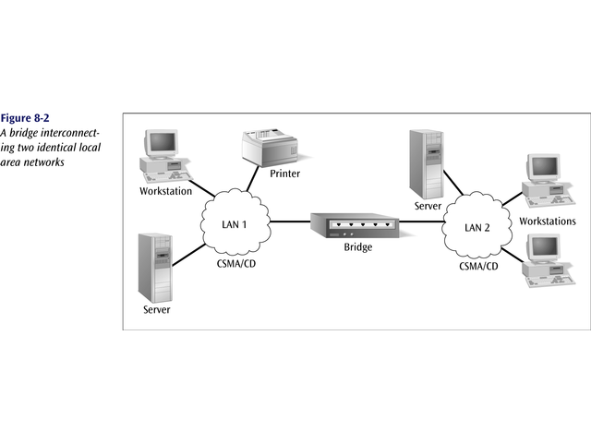
Bridge interconnecting two identical LANs

Slide 25
Switches
A switch is a combination of a hub and a bridge.
It can interconnect two or more workstations, but like a bridge, it observes traffic flow and learns.
When a frame arrives at a switch, the switch examines the destination address and forwards the frame out the one necessary connection.
Workstations that connect to a hub are on a shared segment.
Workstations that connect to a switch are on a switched segment.

Slide 26
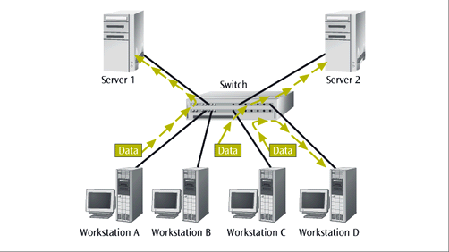
Switch Example

Slide 27
Routers
Thus, routers are often called “layer 3 devices”. They operate at the third layer, or OSI network layer, of the packet.
Routers often incorporate firewall functions.
An example of a router’s operation is shown on the next slide.

Slide 28
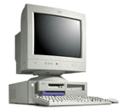
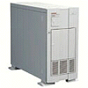
Routers example
Routers send packet to next closest point
H
R
H
H
R
R
R
R
R
H
R
H: Hosts
R: Routers
R
H

Slide 29
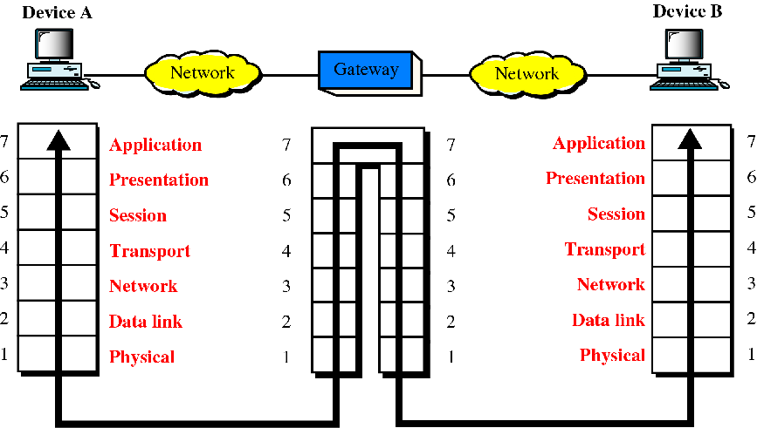
Gateways (protocol converter)

Slide 30

Summary
1. Overview of the OSI Model
2. Computer Network vs Distributed
3. Application of Computer Network
4. System Classification of Network
5. Internetworking devices

Slide 31
Acknowledgement
Slides supplied with Computer Networks by Andrew S. Tanenbaum
Lecture Slide by Prof. Dina Katabi, MIT, Computer Science and Artificial Intelligence Lab
Lecture Slide by Prof. Nick McKeown Computer Science and Electrical Engineering Stanford University
A H M Sarowar Sattar

